Slide 1
We need more GUN CONTROL laws!!
By: Tanvi Wagle

Slide 2
Claim
The United States needs more legislation for gun control because gun control laws are effective in creating a better society.

Slide 3
Examples of State Gun Control Laws
Background Checks
21 Age limit for possession of handgun
Can carry concealed handgun only with permit
Assault-weapons ban
People with violent misdemeanors cannot own a gun
Note: Gun Control Laws vary from state to state.

Slide 4
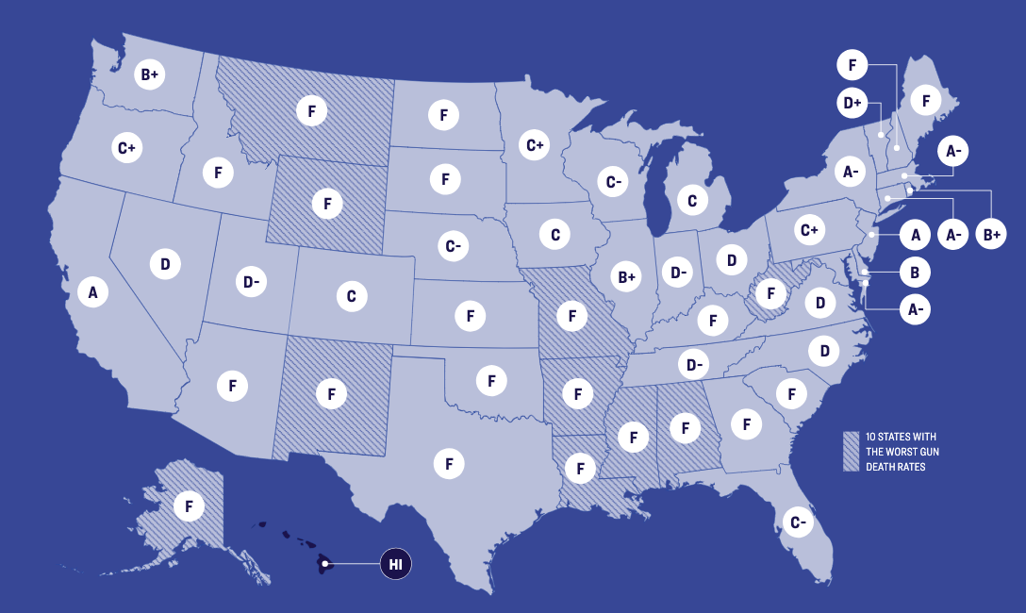
Reason #1: Gun Control Reduces Gun Death Rate
The Graph to the right shows a map of the United States with each state given a “grade” for the level of gun control.
A = Hard to get a gun
F = Easy to get a gun
The slightly darker lined countries are those with the worst gun death rates in America
Giffords Law Center to Prevent Gun Violence

Slide 5
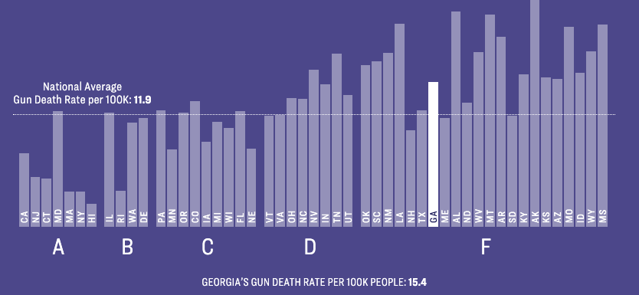
Reason #1: Gun Control Reduces Gun Death Rate
Generally, states with stronger gun control laws (A) result in significantly less deaths than countries with looser gun control laws.
Giffords Law Center to Prevent Gun Violence

Slide 6
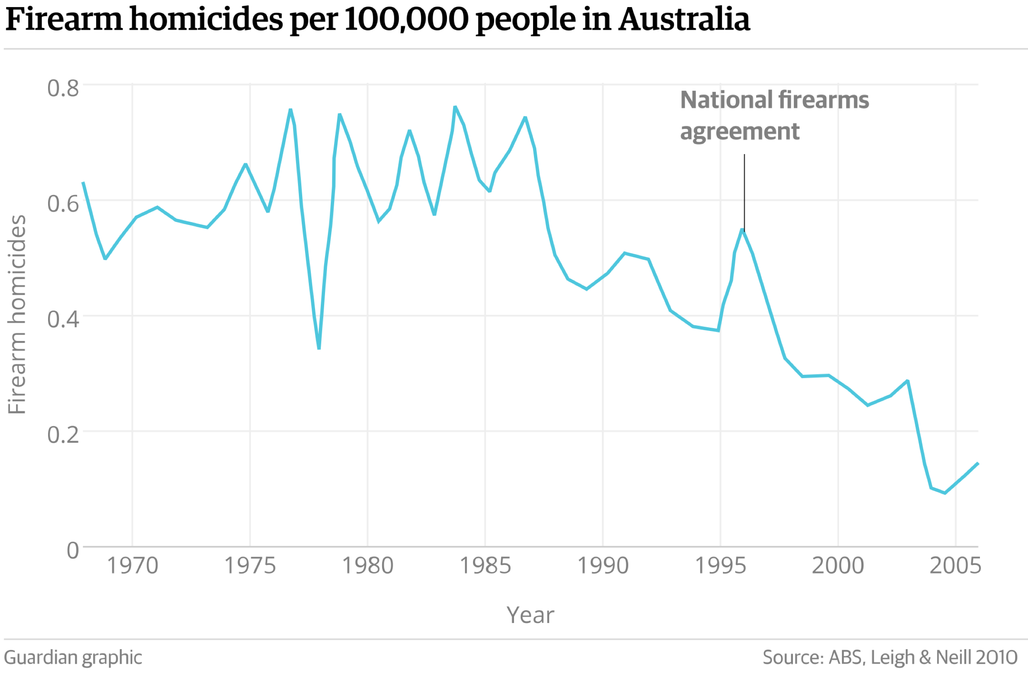
Reason #2: Guns Control has been effective in other countries
Australia had a “wake-up call” 20 years ago when Martin Bryant went on a shooting spree killing 30 people in half in hour.
The Prime Minster of Australia introduced the National Firearms Agreement which implemented several methods of gun control.
This resulted in no mass shootings in the 20 years since the law was implemented.

Slide 7
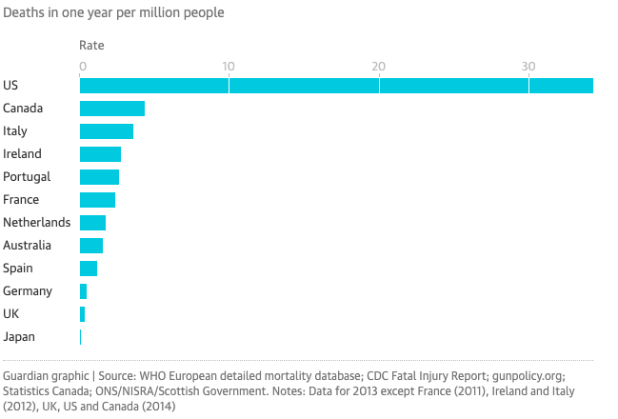
Reason #2: Guns Control has been effective in other countries
United States has the largest gun related deaths in comparison to other developed countries.
Notes:
https://www.criminaljusticedegreehub.com/debate-gun-control-effective/

Slide 8
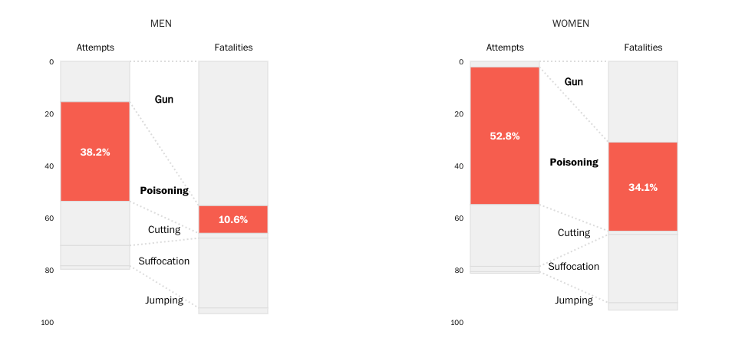
Reason #3: More specifically, Gun Control reduces the number of suicides.
Guns are the most common method for people to commit suicide
Kim Soffen, Washington Post

Slide 9
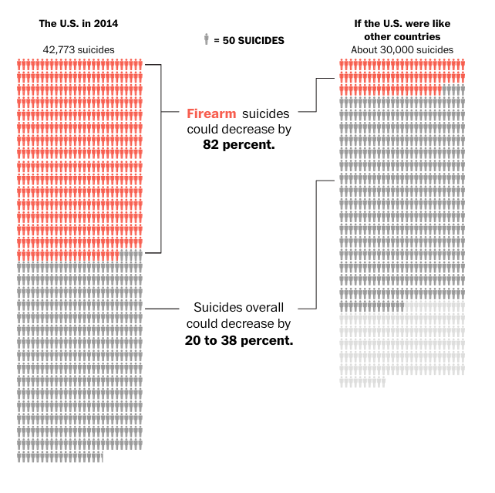
Reason #3: More specifically, Gun Control reduces the number of suicides.
“Research shows that the longer it takes someone to obtain a weapon — such as if they have to go out and buy one or if the state has a mandatory waiting period — the more likely they are to decide against killing themselves or choose an alternative, less lethal method.” – Washington Post
The Washington Post

Slide 10
Let’s talk money! Reason #4: Gun Violence is Expensive
Many opponents of gun control claim that implementing gun control laws would result in America’s Gun Industry loosing a lot of money for no reason.
Gun Industry Estimated Worth = $28 Billion
In fact, Gun Violence is significantly MORE EXPENSIVE than the Gun Industry. Therefore, gun control would help reduce societal costs associated with gun violence.
At least 50% of the gun violence costs are paid by taxpayers
Giffords Law Center to Prevent Gun Violence
Pacific Institute for Research and Evaluation
Notes:
https://www.criminaljusticedegreehub.com/debate-gun-control-effective/
https://www.forbes.com/sites/elizabethmacbride/2018/11/25/americas-gun-business-is-28b-the-gun-violence-business-is-bigger/#6427e72f3ae8
https://lawcenter.giffords.org/costs-of-gun-violence-statistics/
https://www.citylab.com/life/2019/04/gun-control-firearms-law-deaths-shooting-state-data-research/586363/

Slide 11
Conclusion
American Society needs more gun control because…
It Reduces the number of Gun Related Deaths
Has been effective in other countries
Reduces the number of suicides
Gun violence is expensive

Slide 12
References
https://www.criminaljusticedegreehub.com/debate-gun-control-effective/
https://www.forbes.com/sites/elizabethmacbride/2018/11/25/americas-gun-business-is-28b-the-gun-violence-business-is-bigger/#6427e72f3ae8
https://lawcenter.giffords.org/costs-of-gun-violence-statistics/
https://www.citylab.com/life/2019/04/gun-control-firearms-law-deaths-shooting-state-data-research/586363/
https://www.theguardian.com/us-news/2016/mar/15/so-america-this-is-how-you-do-gun-control
https://www.washingtonpost.com/graphics/business/wonkblog/suicide-rates/

